Slide 1

HIGH ENERGY PARTICLE PHYSICS EVENT CLASSIFICATION

Slide 2


Introduction
Welcome to the presentation on Deciphering Particle Physics Events: A Classiﬁcation Approach. We will explore fundamentals of high energy particle physics and Machine Learning algorithms used to classify the event.

Slide 3
PROBLEM STATEMENT
IN THE FIELD OF PARTICLE PHYSICS, ACCURATE IDENTIFICATION AND CLASSIFICATION OF EVENTS ARE CRUCIAL FOR UNDERSTANDING FUNDAMENTAL PARTICLES AND THEIR INTERACTIONS. THE PROVIDED DATASET CONTAINS VARIOUS FEATURES DERIVED FROM PARTICLE PHYSICS EXPERIMENTS, AND THE GOAL IS TO BUILD A MACHINE-LEARNING MODEL TO CLASSIFY EVENTS INTO SIGNAL (S) AND BACKGROUND (B) CATEGORIES. THIS CLASSIFICATION AIDS IN DISTINGUISHING EVENTS OF INTEREST (SIGNAL) FROM BACKGROUND NOISE.

Slide 4
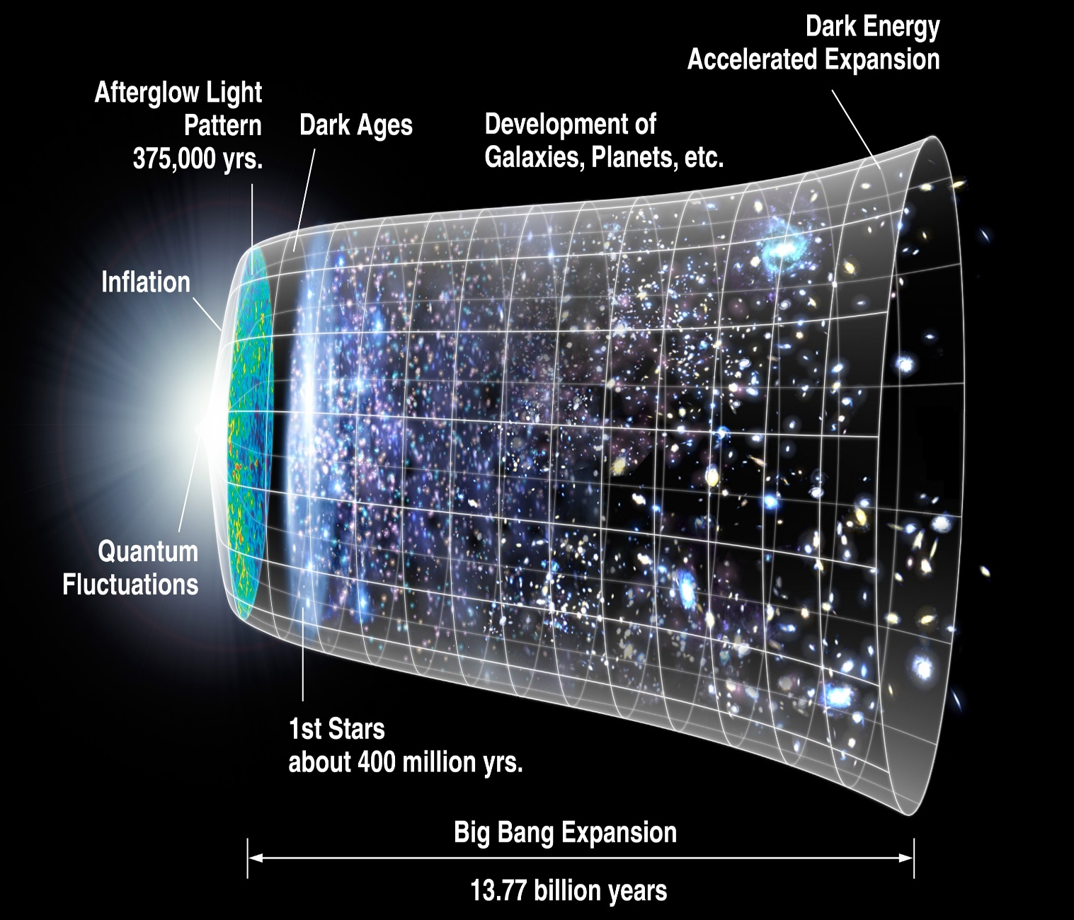
Domain Knowledge: High Energy Physics
To probe into the basic questions on how matter, space and time work and how they are structured, physicists focus on the simplest interactions (for example, collision of subatomic particles) at very high energy.
Particle accelerators enable physicists to explore the fundamental nature of matter by observing subatomic particles produced by high-energy collisions of particle beams. The experimental measurements from these collisions inevitably lack precision, which is where machine learning (ML) comes into picture.

Slide 5
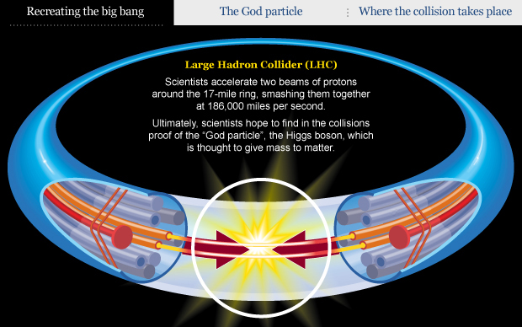
Continue..
In particle physics, an event refers to the results just after a fundamental interaction took place between subatomic particles, occurring in a very short time span, at a well-localized region of space and the background events are particles physicists already know about.

Slide 6
Exploratory Data Analysis
There are total 33 columns and 2,50,000 rows of data.
Target feature aka dependent variable is the column which machine learning model predicts.
Out of 33 features 31 columns are of float data type and 1 column is of integer data type.
And Target feature is categorical {Nominal data type}

Slide 7
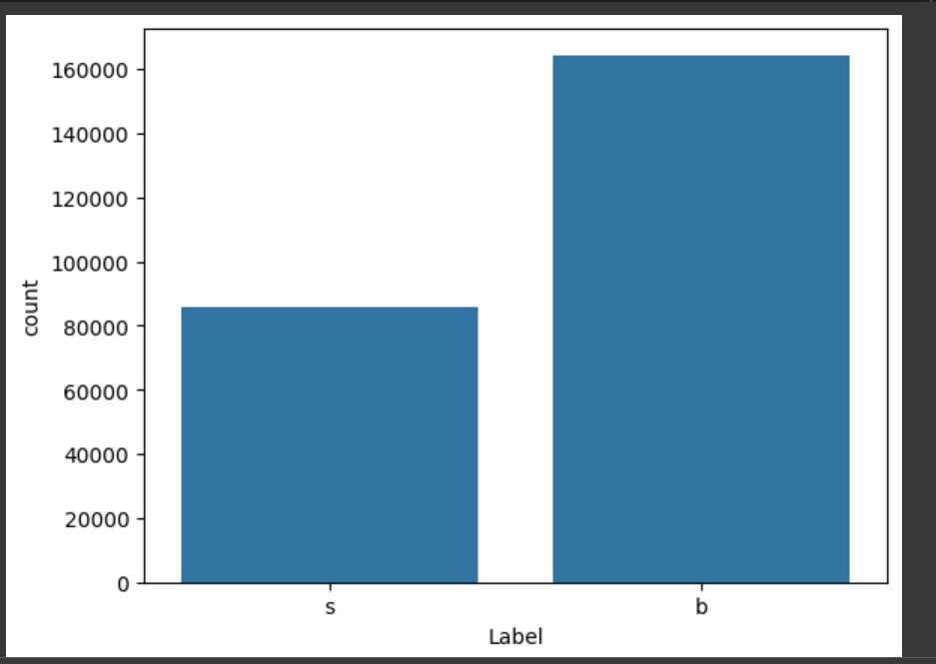
Continue…
In label we have Signal (s) and Background (B)
By this count plot we can
observe that this is a case of
imbalanced class.

Slide 8
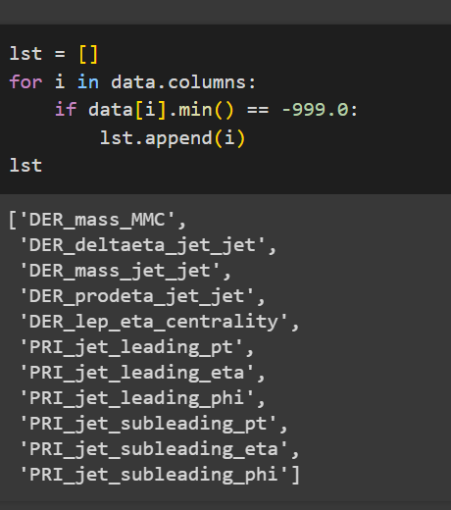
Missing/Insignificant Values
More than 70% of the events lack at least one feature. The missing values do not result from flaws in the simulation process, that would be the equivalent of unobserved measurements, but are structurally absent .
For instance, in events where there is no jet (PRI jet num = 0), there is no such a thing as a “leading jet”, thus the associated primitive quantities (PRI jet leading pt, PRI jet leading eta, PRI jet leading eta) are are structurally undefined, and the features derived from these as well. Such data intrinsically live in a lower dimensional subspace of the feature space, determined by its own actual
features. All missing features are related to PRI jet num, except DER mass MMC.

Slide 9
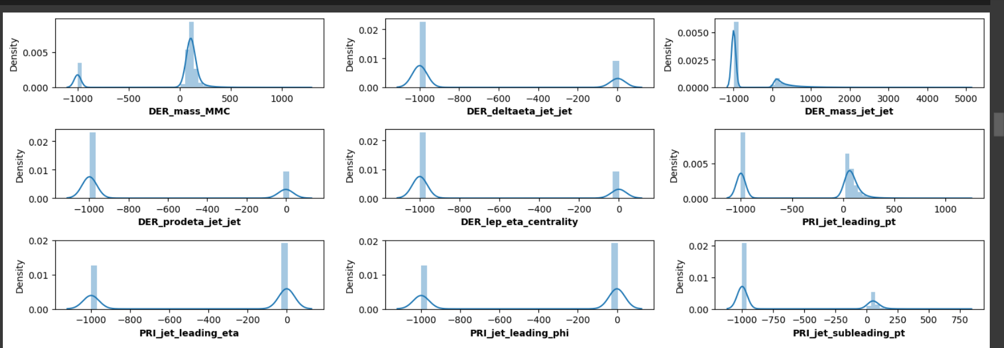
Probability density distribution and Value Imputation
Most of the features which have meaningless value i.e., -999.0 peaks around 0 which means most of the data points are around 0 so we can impute these values to 0.

Slide 10
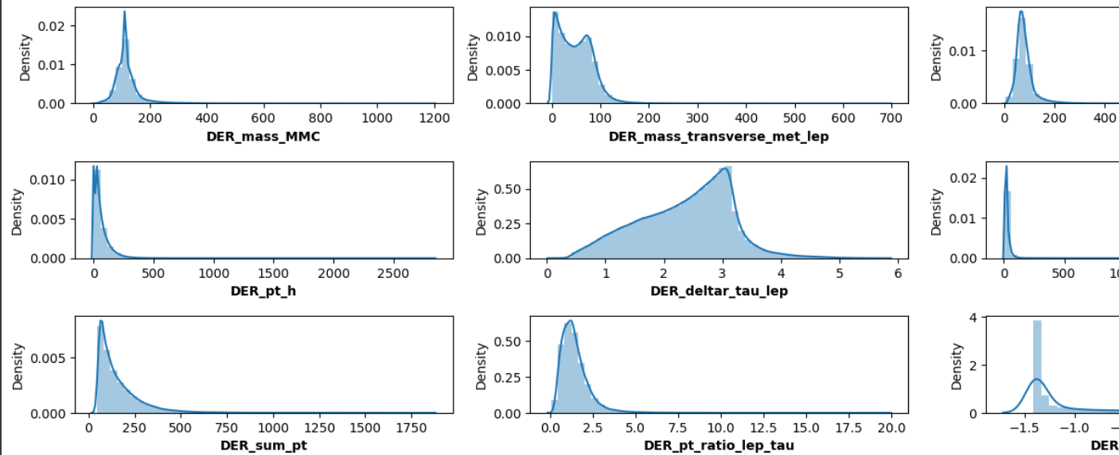
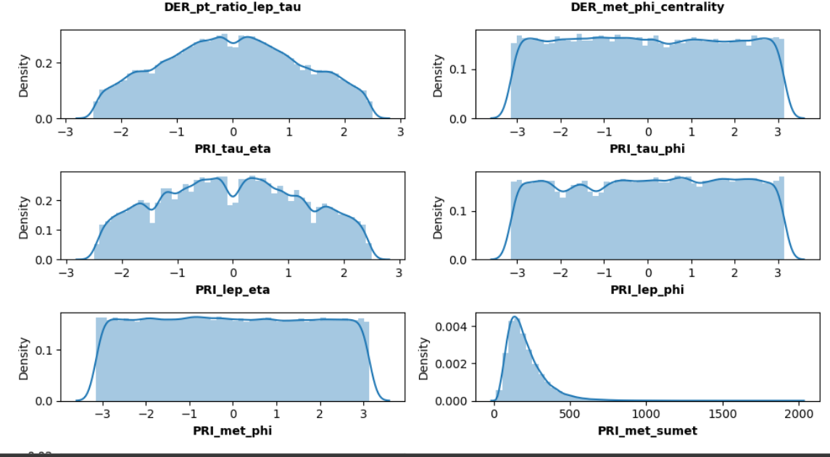
Data Distribution
Data distribution is
Uniform for some
Features and some
Are skewed.

Slide 11
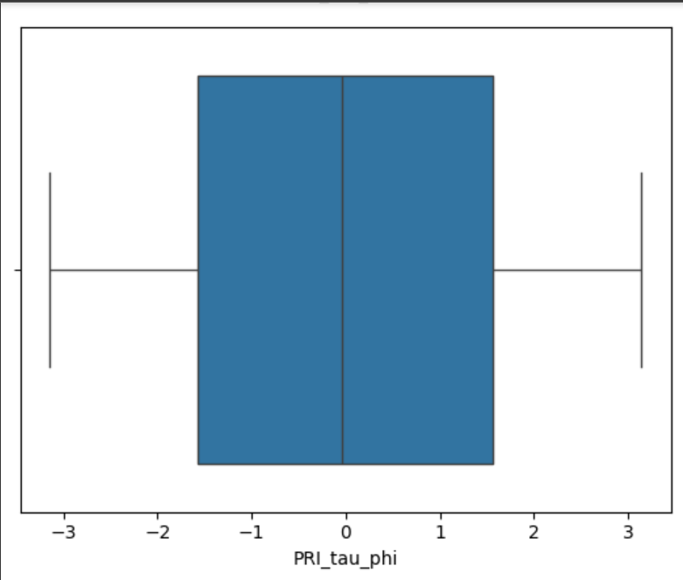
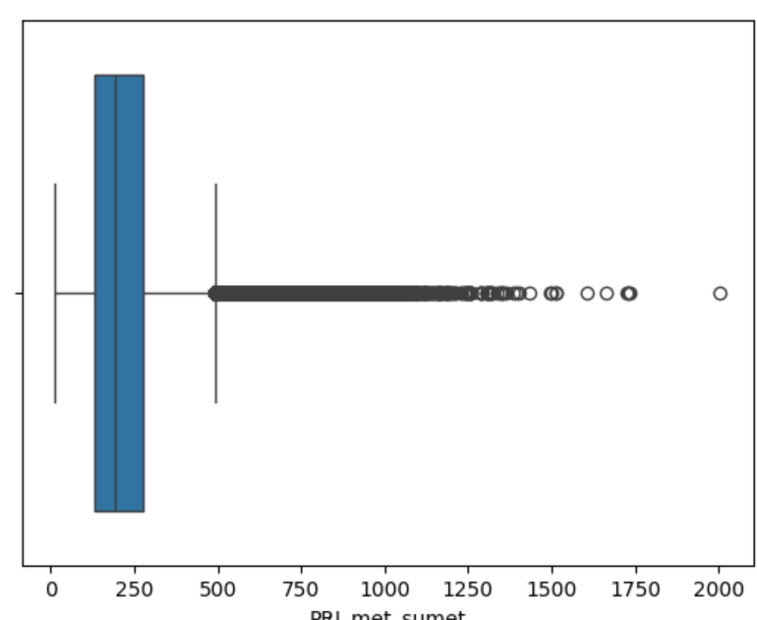
OUTLIERS
Outliers are the data points
Which are at far ends from most
Of the data points.
Boxplot is usually used to find
The presence of outliers.

Slide 12
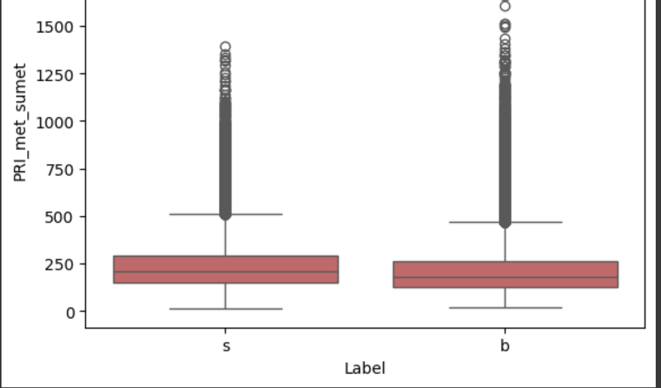
Are outliers telling us something?!
Before treating Outliers we need to see
Whether presence of outlier is indicative
of presence of our desired signal.
For that we can plot boxplot for
Signal and background event with every
Feature to see whether these outliers are
Relevant or not!

Slide 13
Outlier Treatment
Presence of outliers can negatively affect learning of model so treatment of outlier is imperative.
It can be done by Interquartile Range method, we cap the extreme values in a range so that those extereme values won’t affect our training process.

Slide 14
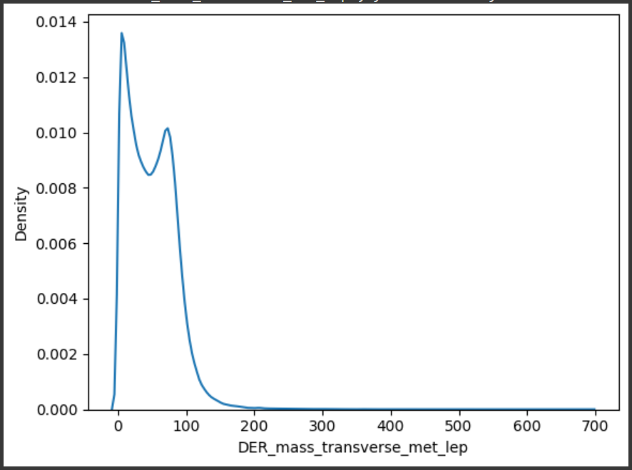
Univariate Analysis Analysis of only single variable
The mass of Higgs boson candidate has broad distribution which produces a very large peak at a slightly lower mass.

Slide 15
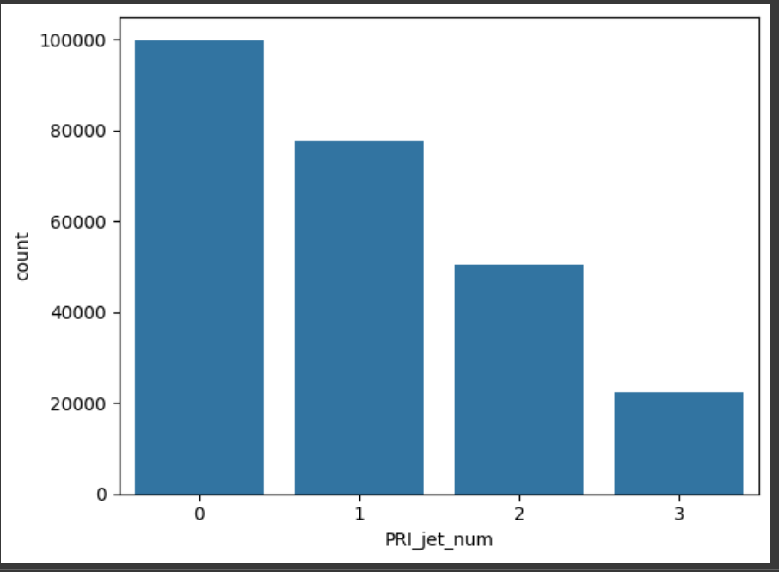
How many Number of jets can be observed in the accelerator while collision?
There are few instances where jets are more than 0.

Slide 16
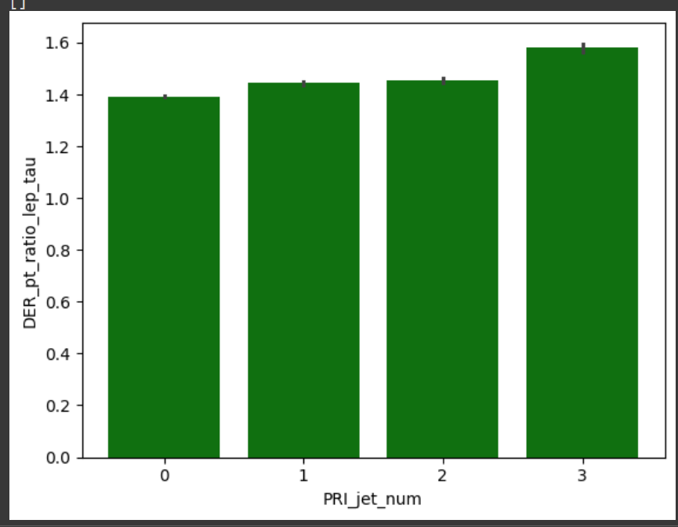
Bivariate Analysis Analysis of two feature vectors
Whenever we need to find new particles these subatomic particles should be studied.
Relationship between R separation of lepton and hadronic tau and numbers of jets.
It has been observed that for higher
number of jets R separation
is highest.

Slide 17
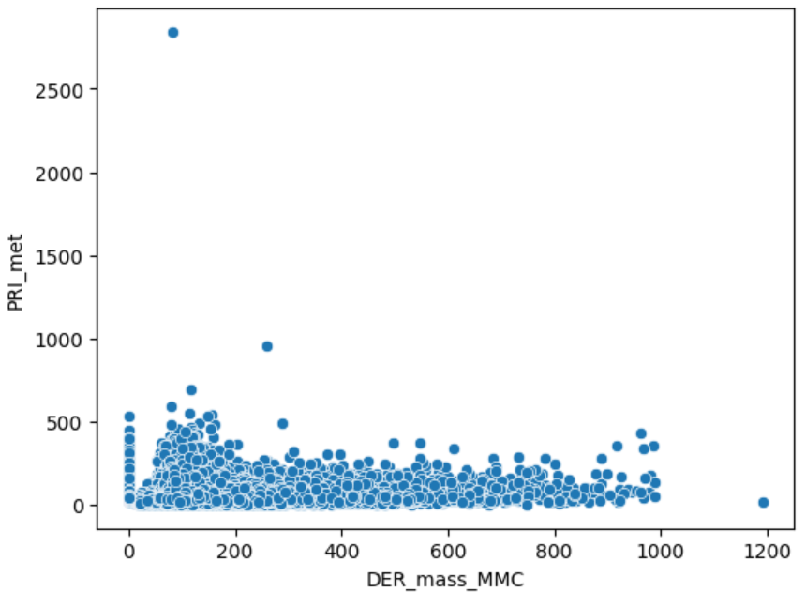
Missing Transverse energy and Mass of Higgs boson candidate relationship
At lower mass high energy can be observed.

Slide 18
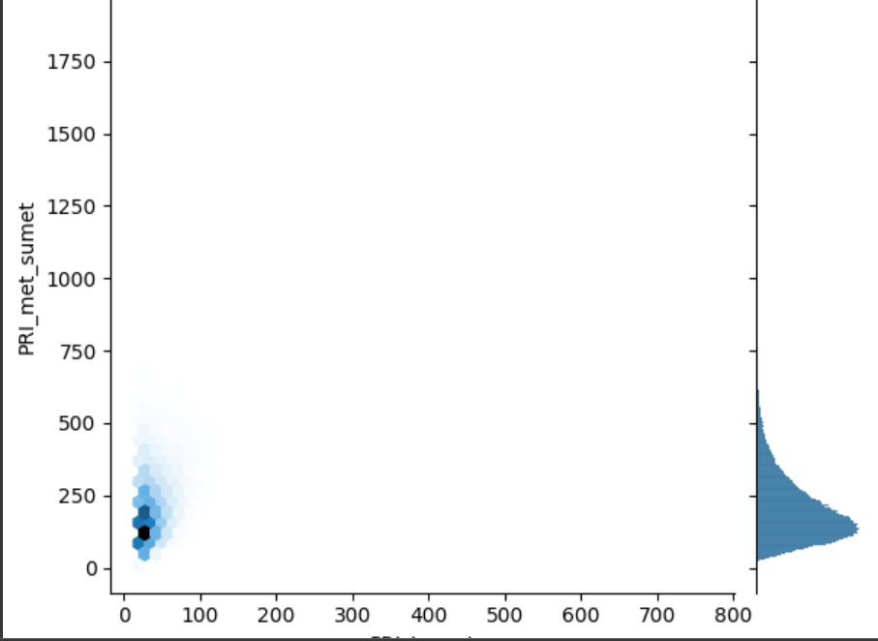
Joint-Plot
In this joint plot we can
observe most data points
Primitive tau-lepton energy
Is between 0 and 100 for
Primitive sub-leading
Transverse energy.

Slide 19
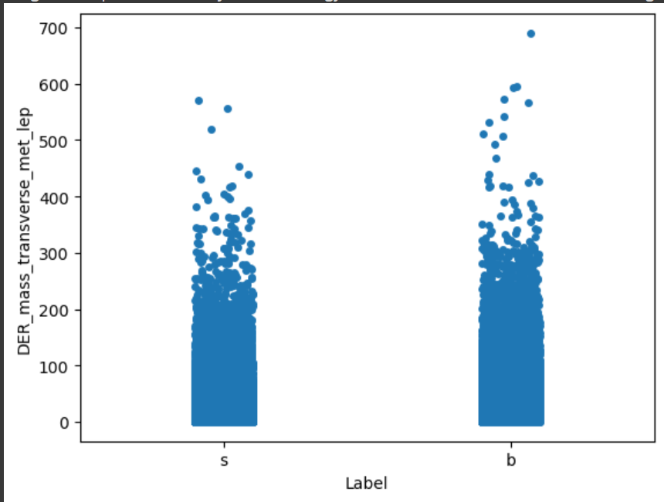
Strip plot to find relationship between Label and mass of missing transverse enregy
We can observe background
events have slightly higher
Energy.

Slide 20
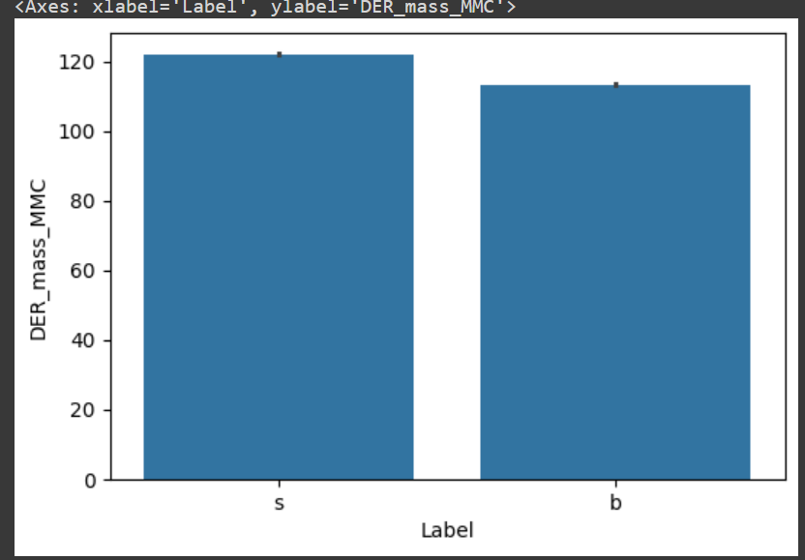
Derived mass of higgs boson candidate can tell us something about presence of new particle hence we would be plotting bar chart between labels and derived mass.
Mass is higher for signal than
background.

Slide 21
ANOVA test
Null hypothesis: There are no significant differences between Azimuthal angles of lepton, Hadron and azimuthal angle of missing transverse energy.
Alternate Hypothesis: There are significant differences between Azimuthal angles of lepton, Hadron and azimuthal angle of missing transverse energy.
We reject null hypothesis as F-stat is more than 1

Slide 22
Correlation Analysis
The following groups have shown extremely high positive correlation structure within themselves, i.e. any two features from a single group has extremely high correlation coefficient.
DER_deltaeta_jet_jet, DER_mass_jet_jet, DER_prodeta_jet_jet, DER_lep_eta_centrality, PRI_jet_subleading_pt, PRI_jet_subleading_eta, PRI_jet_subleading_phi
DER_sum_pt, PRI_met_sumet, PRI_jet_all_pt
PRI_jet_leading_pt, PRI_jet_leading_eta, PRI_jet_leading_phi
So these can be dropped.

Slide 23
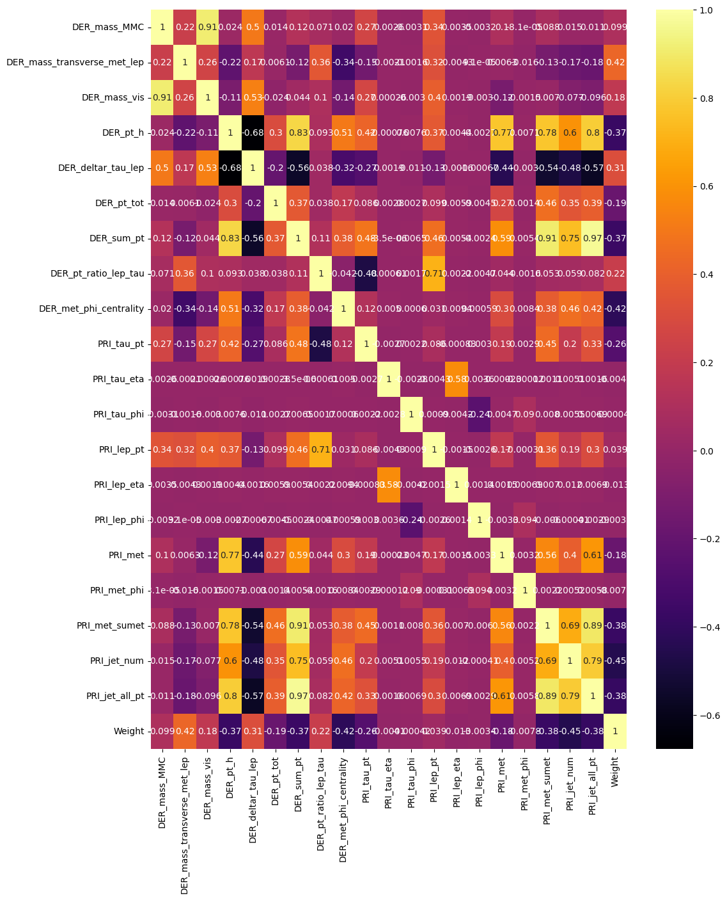

Slide 24

Feature Engineering
RemovingHighlyCorrelatedColumns
MissingValueTreament
Engineering relevant features such as momentum, energy, and angles to eﬀectively classify particle physics events and diﬀerentiate between signal and background.
Removing unwanted data points, highly correlated columns, and keeping only needed features.

Slide 25
Data Preprocessing
Encoding
Splitting data into training and testing
Sampling to balance the imbalanced class.
Encoding the categorical value
Splitting data into Training and Testing.
Doing sampling to manage the imbalanced classes.

Slide 26
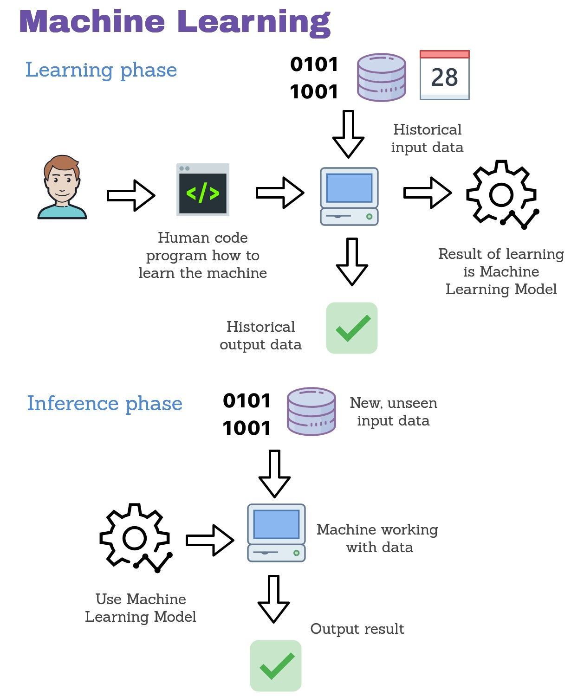
CLASSIFICATION TECHNIQUES
As this is a binary classification problem we can use
Logistic Regression
Support Vector Machine
Decision Tree
Boosting Algorithms like ADAboost, Xgboost etc.

Slide 27
Model building process
Training
Giving Historical data
Learning
Model learns the underlying pattern of data
Prediction
Model does the prediction of target variable
Initialization of model

Slide 28
Hyper Tuning Model Parameters
With the abundance of hyperparameter options available, two popular techniques, Random Search CV and Grid Search CV, have emerged as effective approaches to fine-tuning models.
Rather than systematically examining all possible combinations, Random Search CV selects a fixed number of combinations randomly.
Grid Search CV is a technique that exhaustively searches through a predefined grid of hyperparameter values. It systematically evaluates the model's performance for each combination of hyperparameters specified in the grid.

Slide 29
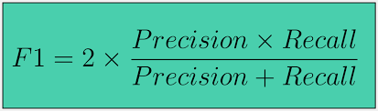
Evaluation Metrics
Using accuracy, precision, recall, and F1 score to evaluate the performance of classiﬁcation models in deciphering particle physics events.
The F1 score is a measure of a model’s accuracy that takes into account both precision and recall, where the goal is to classify instances correctly as positive or negative. Precision measures how many of the predicted positive instances were actually positive, while recall measures how many of the actual positive instances were correctly predicted.

Slide 30
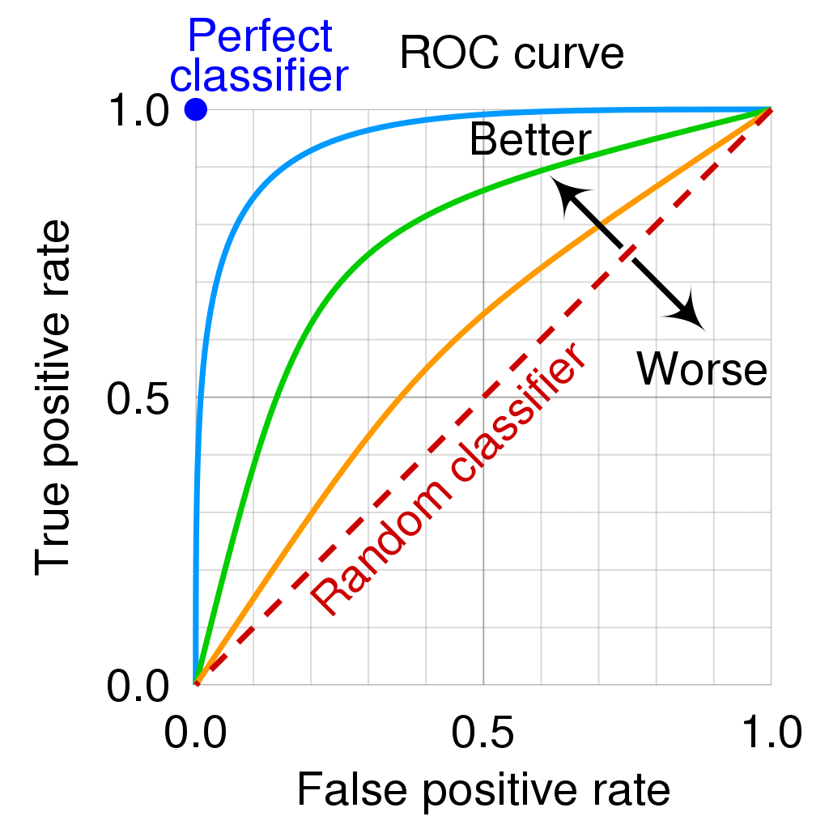
ROC-AUC Curve
The ROC (Receiver Operating Characteristic) curve and AUC (Area Under the Curve) are ML metrics used to evaluate the performance of binary classification models

Slide 31
Comparison of Evaluation Metrics for various ML algorithms
Machine Learning Model | Accuracy without Hyper Parameter Tuning | Accuracy with Hyperparameter Tuning | ROC-AUC Curve Value
Logistic Regression | Train-72.61% Test-72.22% | - | 73%
Decision Tree | Train-100% Test-76.35% | Train-80% Test-79% | 80%
Random Forest | Train-99.99% Test-84% | Train-82% Test- 81.4% | 82%

Slide 32
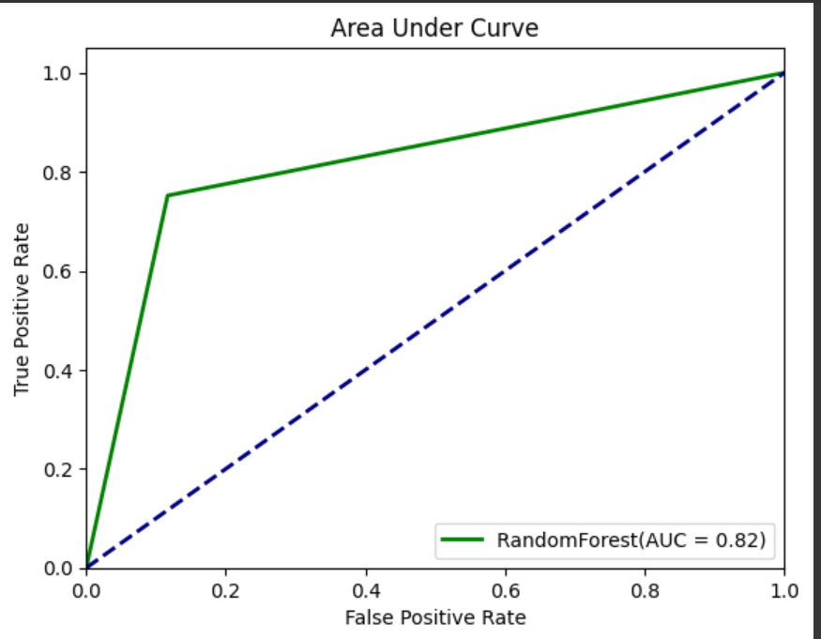
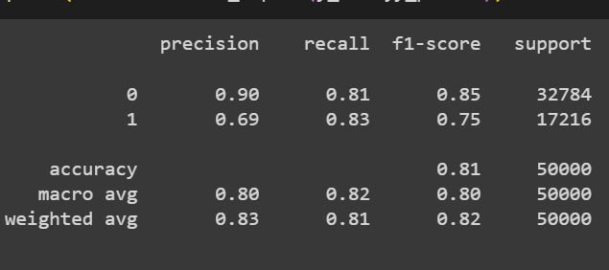
Evaluation Metrics
Accuracy on the train set:
0.814
Accuracy on the test set:
0.814

Slide 33
Challenges Faced
When made model with weight feature every model was overfitting, did feature importance and found out that most model used only weight column in its training.
By doing research found out that weight feature is a scaling factor given by physicist to give weightage of signal and background but this feature would not be present in real time
Hence dropped the column to make ml model more realistic with weight feature column these were the accuracy.
Model | AUC score | AUC SCORE with regularization and tuning
Logistic Regression | 99 | 96
Support Vector Machine | 97 | 93
Decision Tree and AdaBoost | 100 | 100

Slide 34


Exploring the potential of deep learning and quantum computing in advancing the classiﬁcation of particle physics events for future discoveries.
Making computation of ML models with less latency and less power consumption.

Slide 35


In conclusion, the classiﬁcation approach oﬀers a powerful tool for deciphering particle physics events, paving the way for new discoveries and advancements in the ﬁeld.

Slide 36


Do you have any questions?
Jvyas114@gmail.com

